Slide 2
I-IOT-801
Smart Trash Cans
IOT – Augmented Reality

Slide 3
Augmented Reality

Slide 4
History
1968, Harvard
Ivan Sutherland
1st Head-mounted display called ‘The Sword of Damocles’
1990, Boeing’s Computer Services Research
Tom Caudell
Coined the term “Augmented Reality”
Developed a software which displayed the position of key cables during construction
Today
AIRBUS
Microsoft HoloLens 2

Slide 5
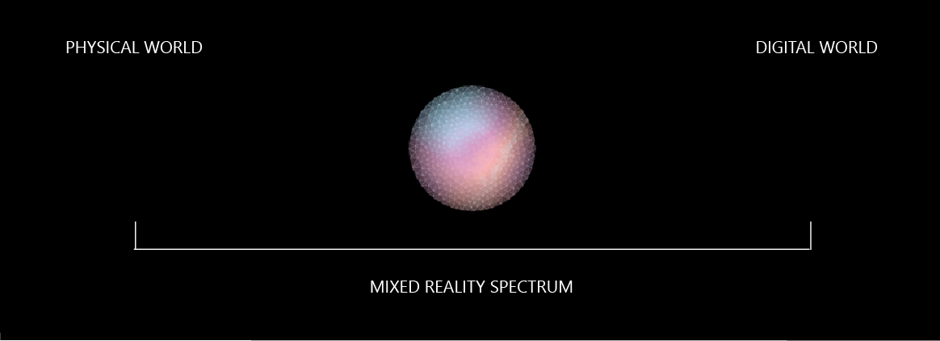

Slide 6
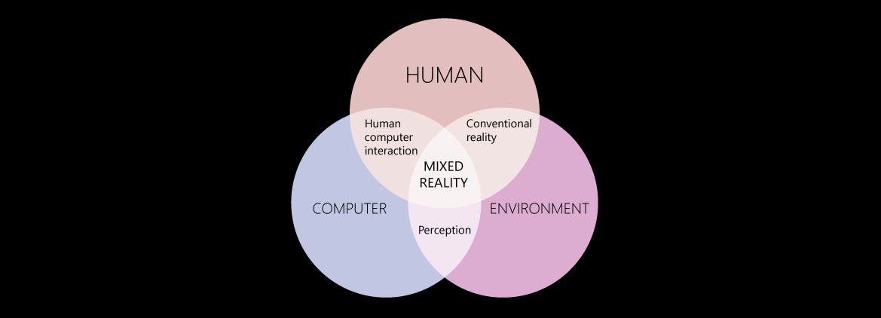

Slide 7
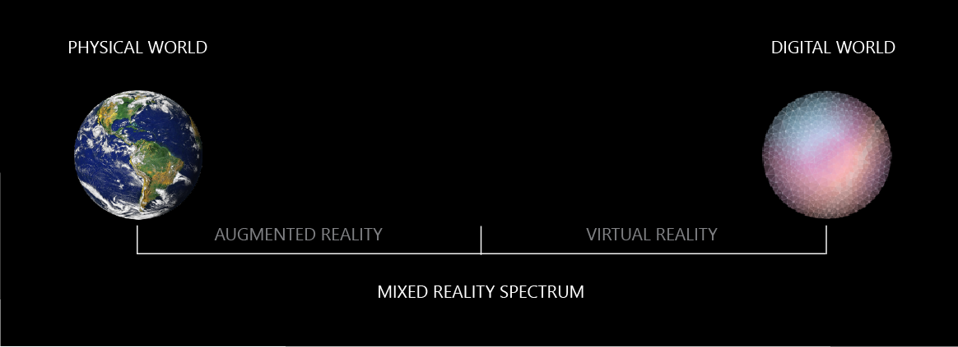

Slide 8
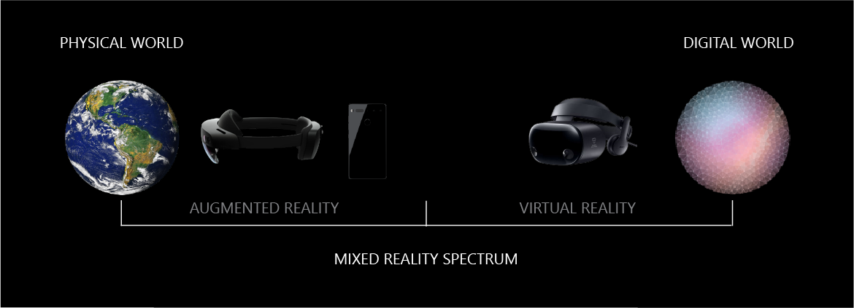

Slide 9
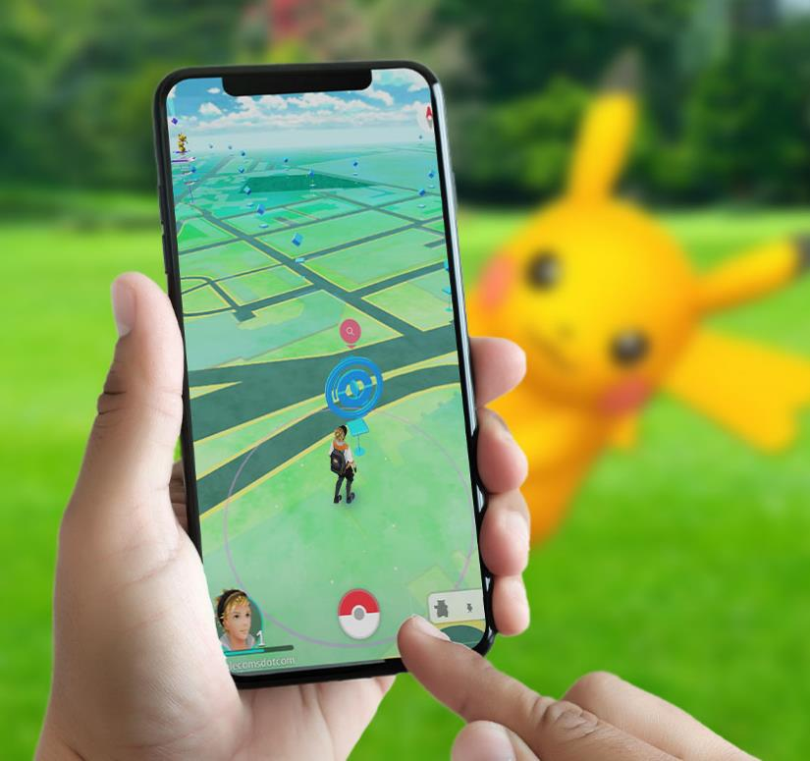
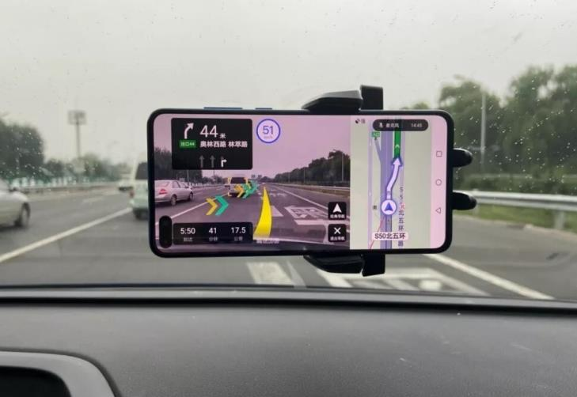
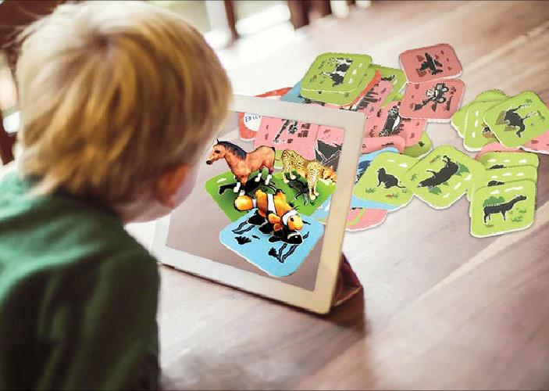
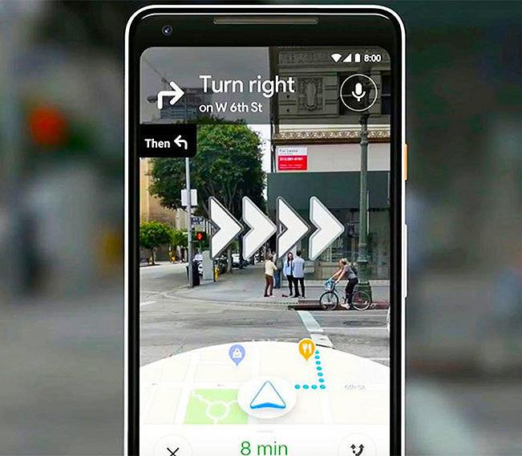
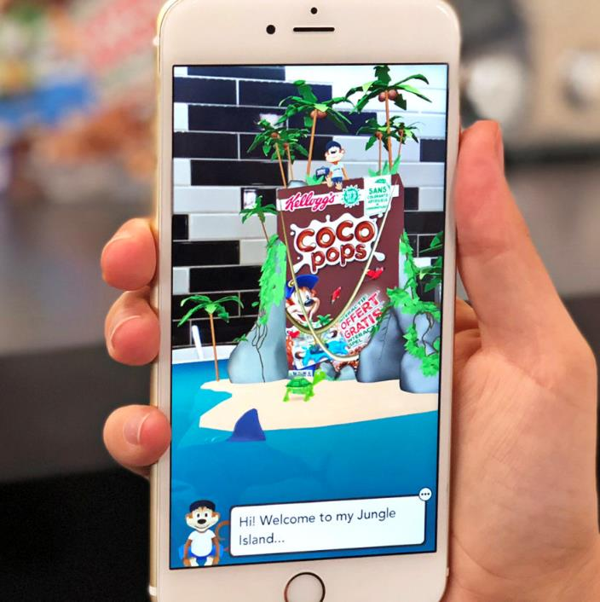
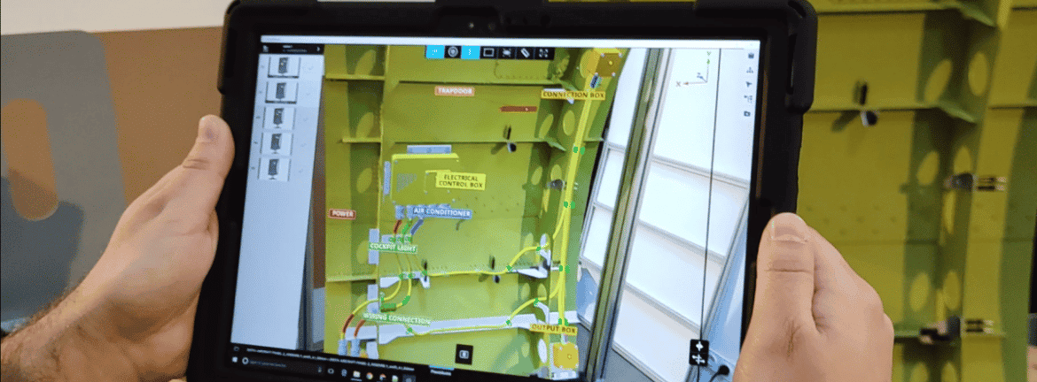
Application Domains

Slide 10
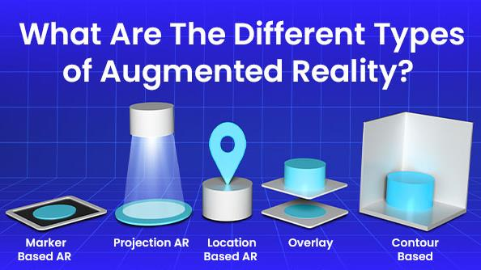

Slide 11
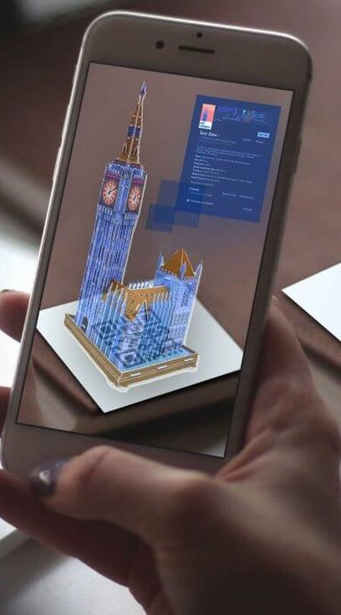
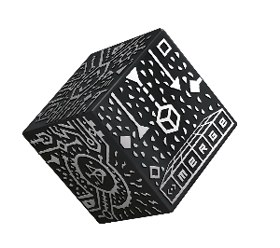

Marker-based AR
Just need a
(2D or 3D) target marker …
… and an overflowing imagination!
or

Slide 12
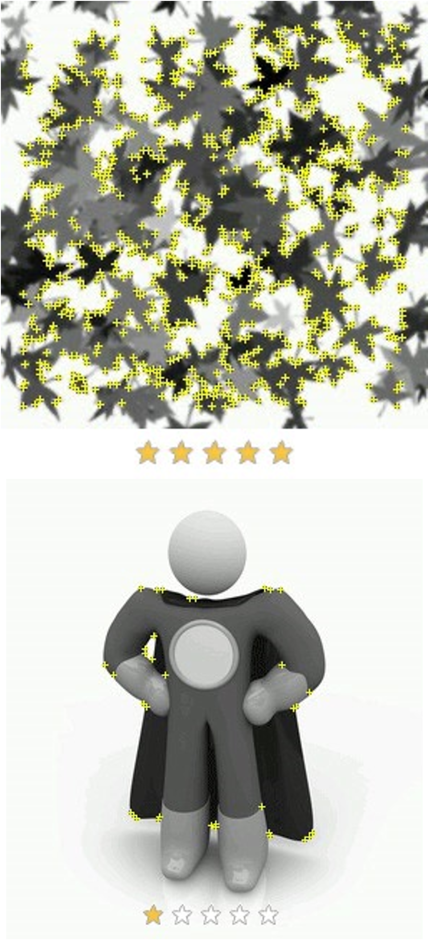
Markers: Best Practices
DOs
  Feature-rich target markers
  Various shapes / curves / shadows
  Distinctive designs
  Bright and clear images
  Large, graphic targets
  Matte finish
  …
DO NOTs
  Minimalist design
  Repeated textures
  Duplicating symbols across markers
  Blurry images or background
  Tiny markers
  Text-heavy markers
  Glossy print-outs
  …

Slide 13
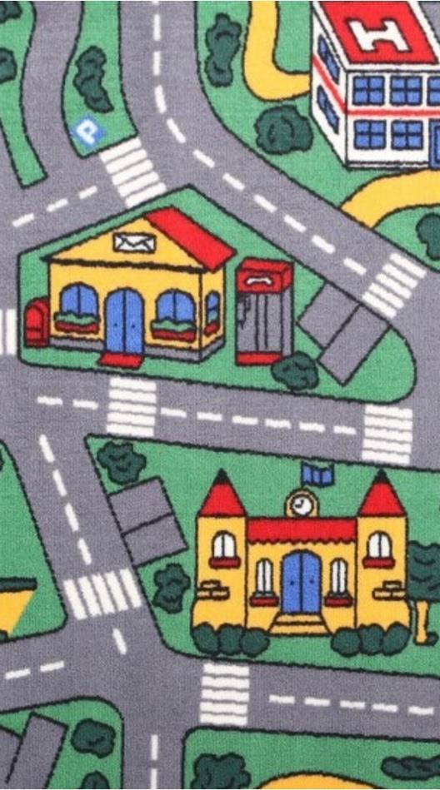
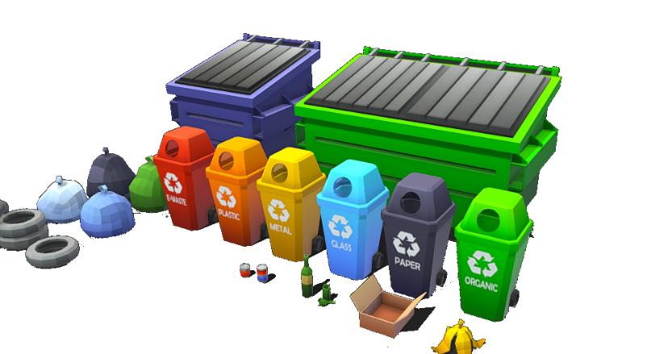
Overlaying data
« Real-life » states of the trash cans
Have you heard of 3D animations ?

Slide 14
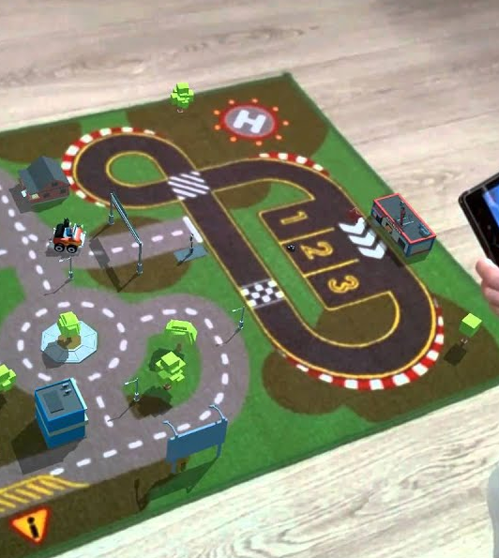
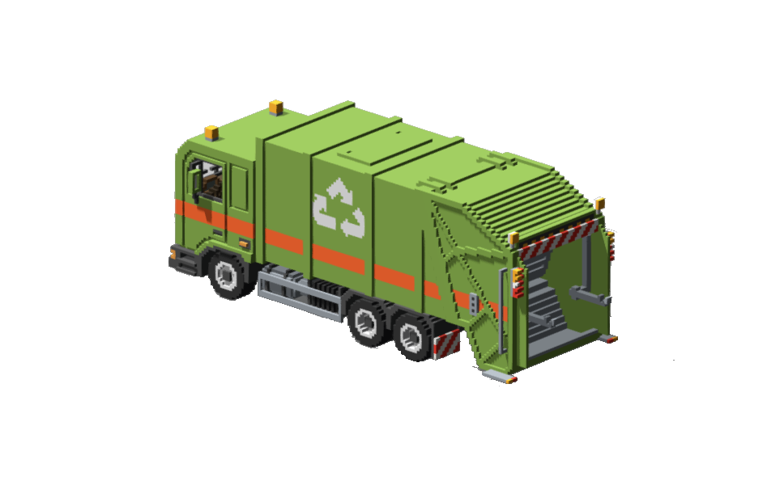

Overlaying data
Garbage truck equipped with a high-performance GPS to optimize journeys
Have you ever heard of “Pathfinding algorithms” ?

Slide 15


Choosing the right engine
Unity3D is recommended but not mandatory!
Why Unity3D?
  Lots of tutorials
  Huge community
  Cross-platform
  Asset store
  SDK manager

Slide 16
IoT

Slide 17
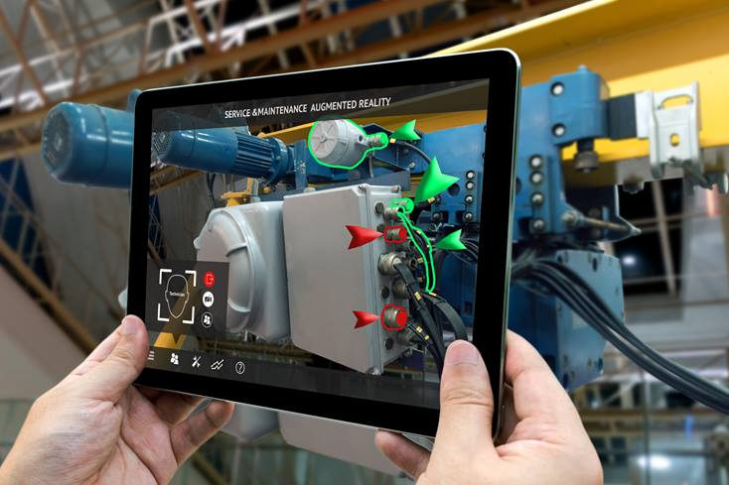
Example : industrial maintenance

Slide 18
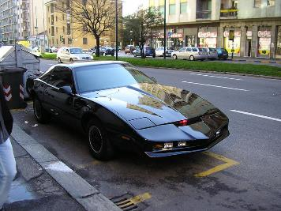
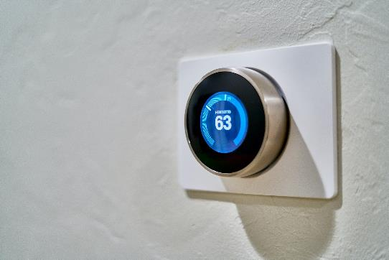
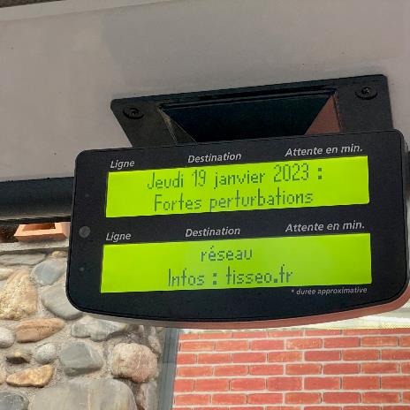
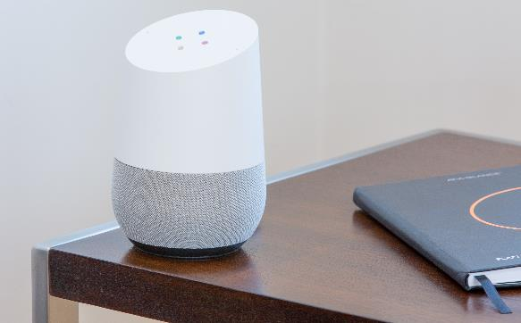
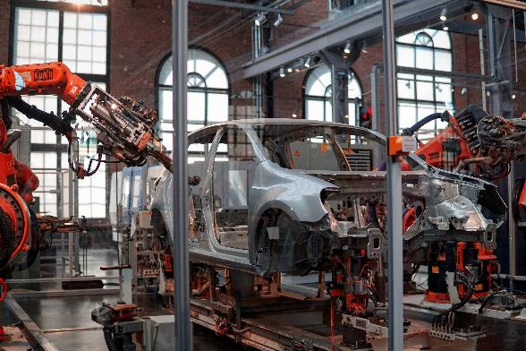
IoT
Internet of the Things
Extremely wide range of applications

Slide 19
How many devices ?
2018 : 7 billions devices
2025 : 21 billion devices (estimated)
Far more connected objects than humans using Internet

Slide 20
IoT
Internet of the Things
Telecommunication
(often radio)
Microcontrollers (MCU)

Slide 21
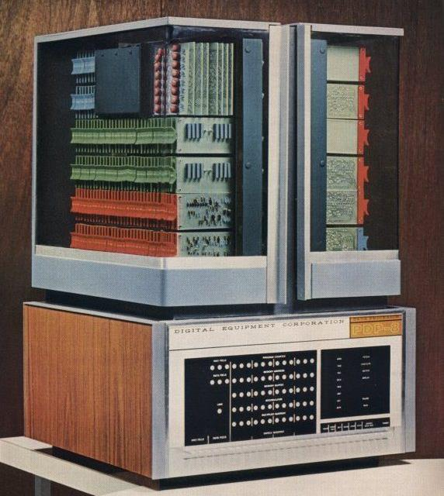
History
PDP-8 (1965-1984)
Designed for research lab automation
Huge success (for the time) : > 50000 units
Why ?

Slide 22
History
PDP-8 (1965-1984)
Designed for research lab automation
Huge success (for the time) : > 50000 units
Why ?
  Low cost
  Easy to use IO bus
  Compact (easy to integrate in a lab)
  12 bits words = suitable range for measures
  (most ADC today are 12 bits)

Slide 23
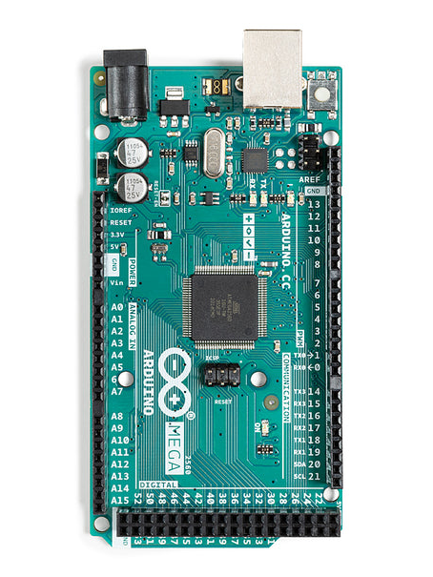
MCU
« Everything on a single chip »
Very few side components needed
  Even quartz is optional

Slide 24
MCU
5V regulator
ATmega16
USB control
« Everything on a single chip »
Very few side components needed
  Even quartz is optional
Quartz
3.3V regulator
MCU (ATMega256)

Slide 25
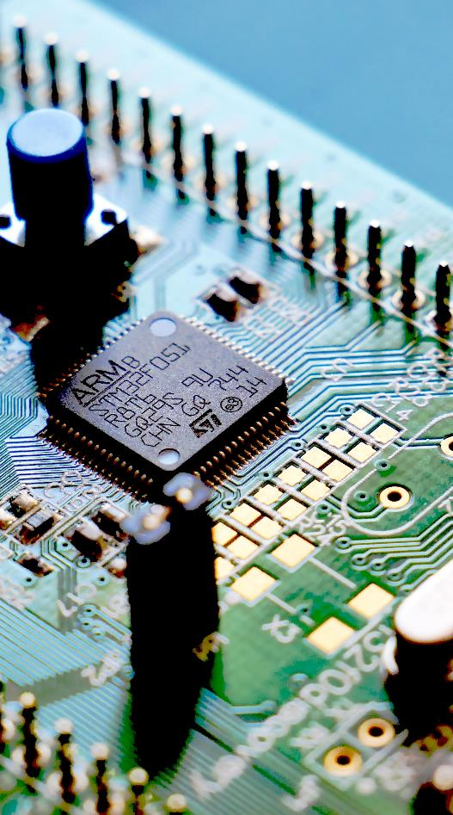
MCU
Integrates all parts of computer (CPU, Flash, RAM, IOs…)
Mostly : single chip board (only the MCU + power)
  Even quartz is optional
Low range CPU :
  8 bits are common
  Low MHz (low power)
Few kB of RAM and Flash
But many IOs

Slide 26
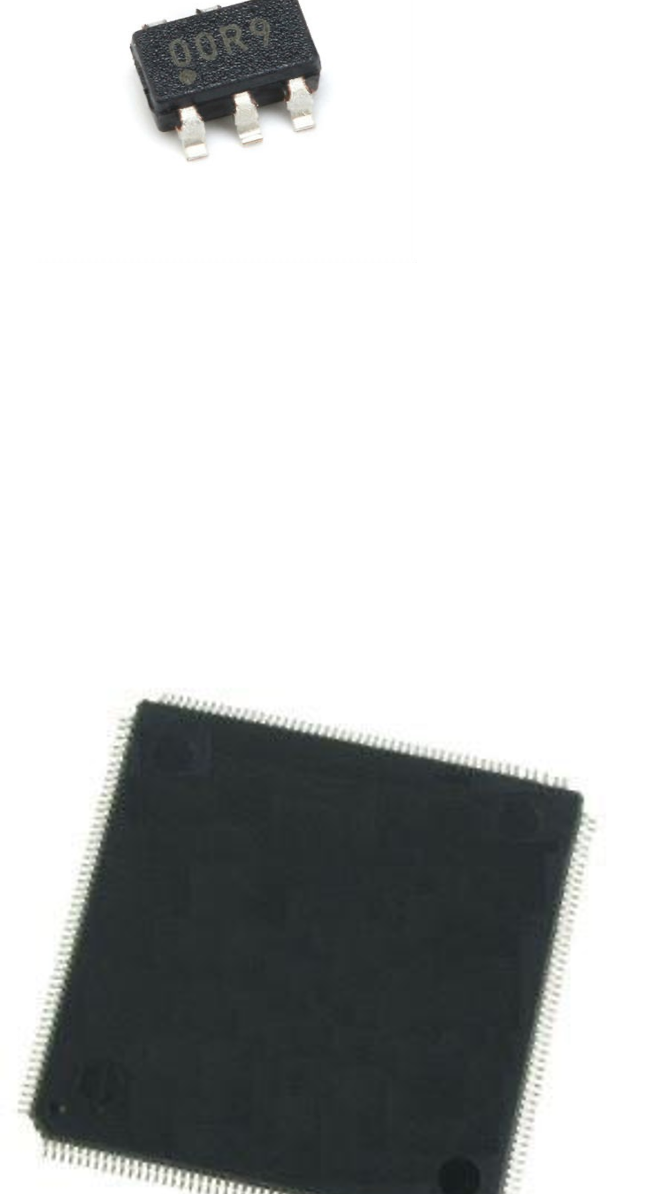
MCU
Mass market
  (billions of units / years)
Cost effective
  (dozen of units in a car ; multiply unit cost by number of produced car…)
Very wide range of MCU
  Cost effective
Time to market

Slide 27
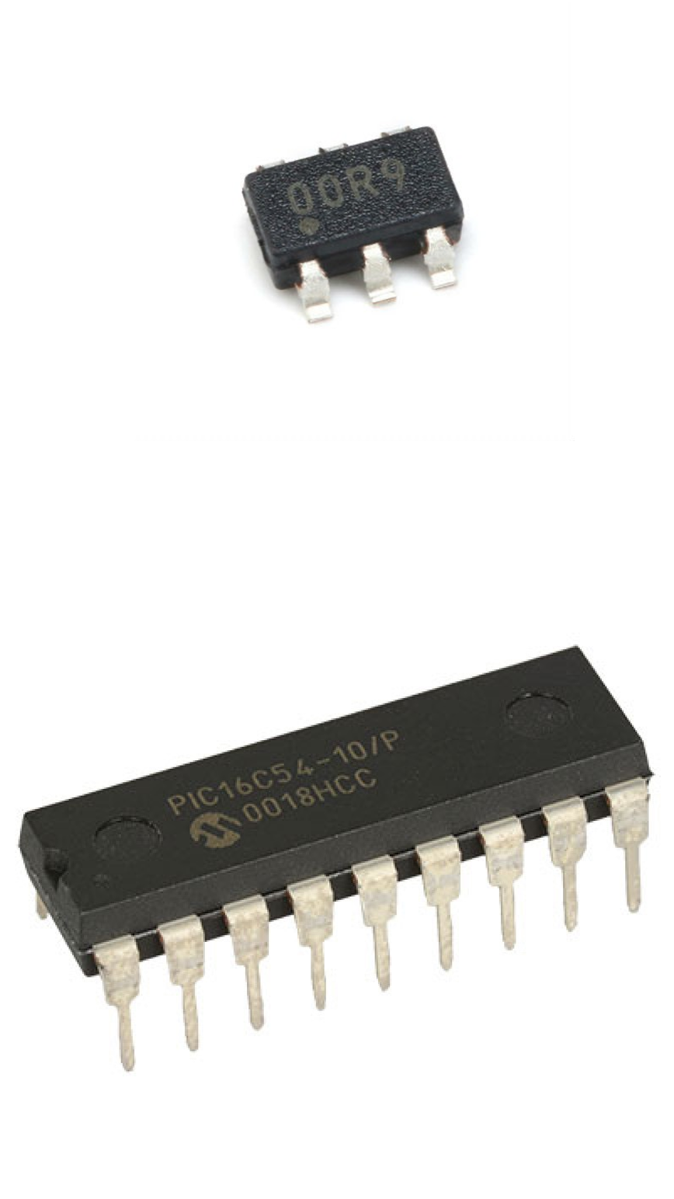
MCU examples
PIC10F200
  6 pins package
  256 words FLASH for programs
  16 bytes RAM
  4MHz
PIC16C54
  18 pins package
  8bit (12 bits instructions), 40 MHz
  ROM : 512 words, RAM 20 bytes
  12 IO pins

Slide 28
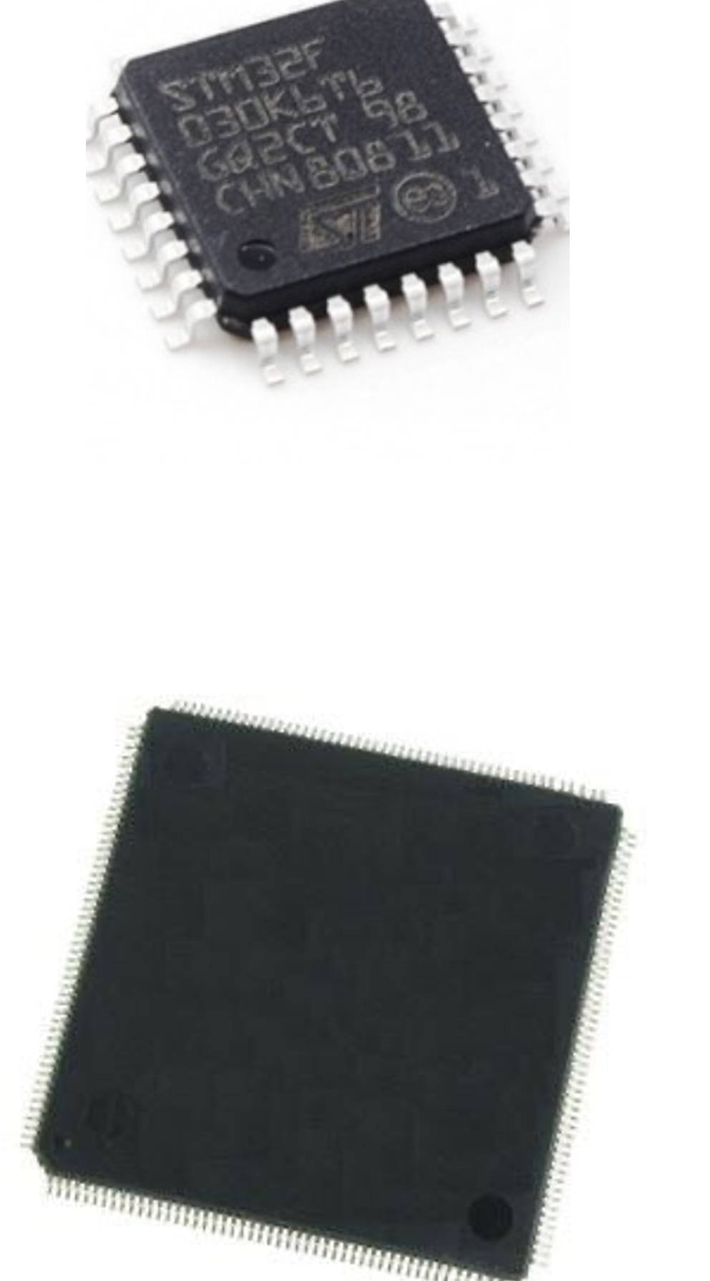
MCU examples
STM32F103
  68K flash, 20K RAM
  ARM 32 bits, 72MHz
  80 GPIO, 7 timers, 9 communication interfaces, 16 ADC channels, 7 DMA channels
STM32H757
  Dual ARM Cortex-M5, 480 MHz
  DP FPU
  JPEG codec, crypto hardware
  2MB FLASH, 1MB RAM

Slide 29
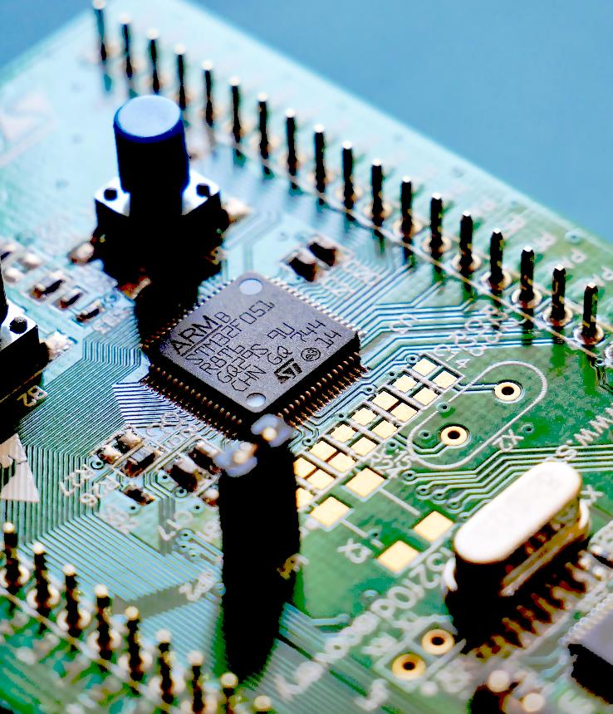
MCU
Low power usage
  For battery powered devices or solar powered
  MCU often have low consumption
  Configurable frequency
  Advanced low power modes

Slide 30
Inputs/Outputs
GPIO
  General purpose IO, can be configured as input or output
Timers
  Some can be used to generate PWM, or as counter
ADC
  Generally multichannel, 12 bits
DAC
  Seldom present, PWM is suitable for many uses
Watchdog

Slide 31
Communication channels
I2C
  Communication with sensors / actuators
CAN
  Communication bus for multiple MCU
  (automotive)
UART
  « old style» serial port, asynchronous or synchronous
SPI
  High speed serial port (serial flash, etc..)
USB, support for ethernet, Wifi, display, etc...

Slide 32
Sensors and actuators
Interaction with real words
Sensors
  Get information from the world
  Can be simple (contact, IR barrier, …)
  MEMS : inertial sensor, pressure measure…
Actuators
  Act on the world
  Generally require external power !
  Motors (DC, step, servo), relay
  Display, LED, audio…
  MEMS (ex: inkjet), DLP…

Slide 33
MCU difficulties
Low memory
  Low level languages
  Design constraints (algorithm choice)
Interaction with real world
  Problems cannot be easily reproduced
  Breakpoint : can’t continue after a breakpoint
  Unit tests are more complex
Hardware/Software
  Both developed simultaneously (often)
  Investigate if problem is hardware or software (or connection)
But often very high reliability expected !

Slide 34
MCU difficulties
Hopefully small programs
Strict methodology
  Never change hardware and software at the same time
  QA standards for automotive, aviation, space
Test environments
  Dedicated hardware that simulate external world
  Cross compilation on PC for tests / debug
  MCU emulation (eg. QEMU)
  …

Slide 35
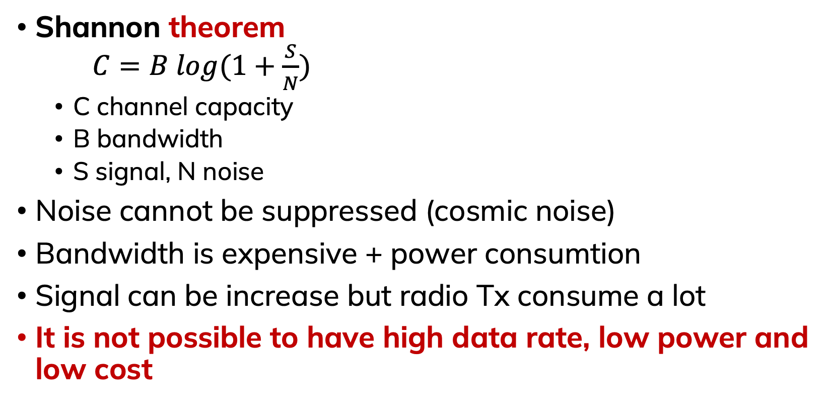
Communication
Shannon theorem
$C=B log(1+\frac{S}{N})$
  C channel capacity
  B bandwidth
  S signal, N noise
Noise cannot be suppressed (cosmic noise)
Bandwidth is expensive + power consumption
Signal can be increase but radio Tx consume a lot
It is not possible to have high data rate, low power and low cost

Slide 36
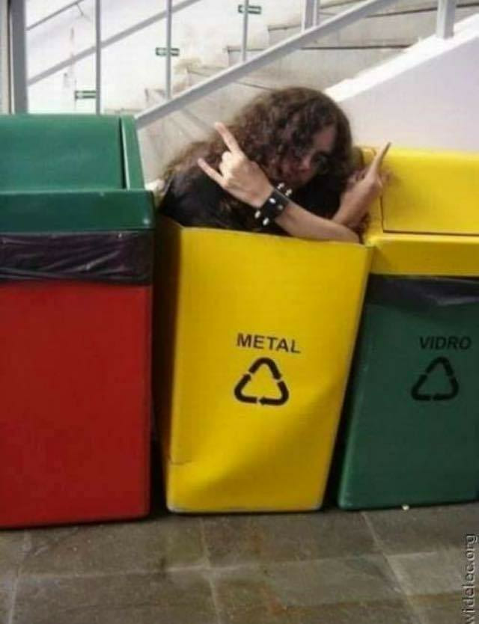
For this project
Discovering of MCU
Discovering of sensors and actuators
Discovering MCU development with both hardware and software
Many of your issues : cable connection, sensor misuse
Wide knowledge requirements
  HW and SW are closely linked
  Datasheets contains a lot of information; one need to get use to find relevant part.
Wi-Fi communication
No power consumption constraints

